Slide 1

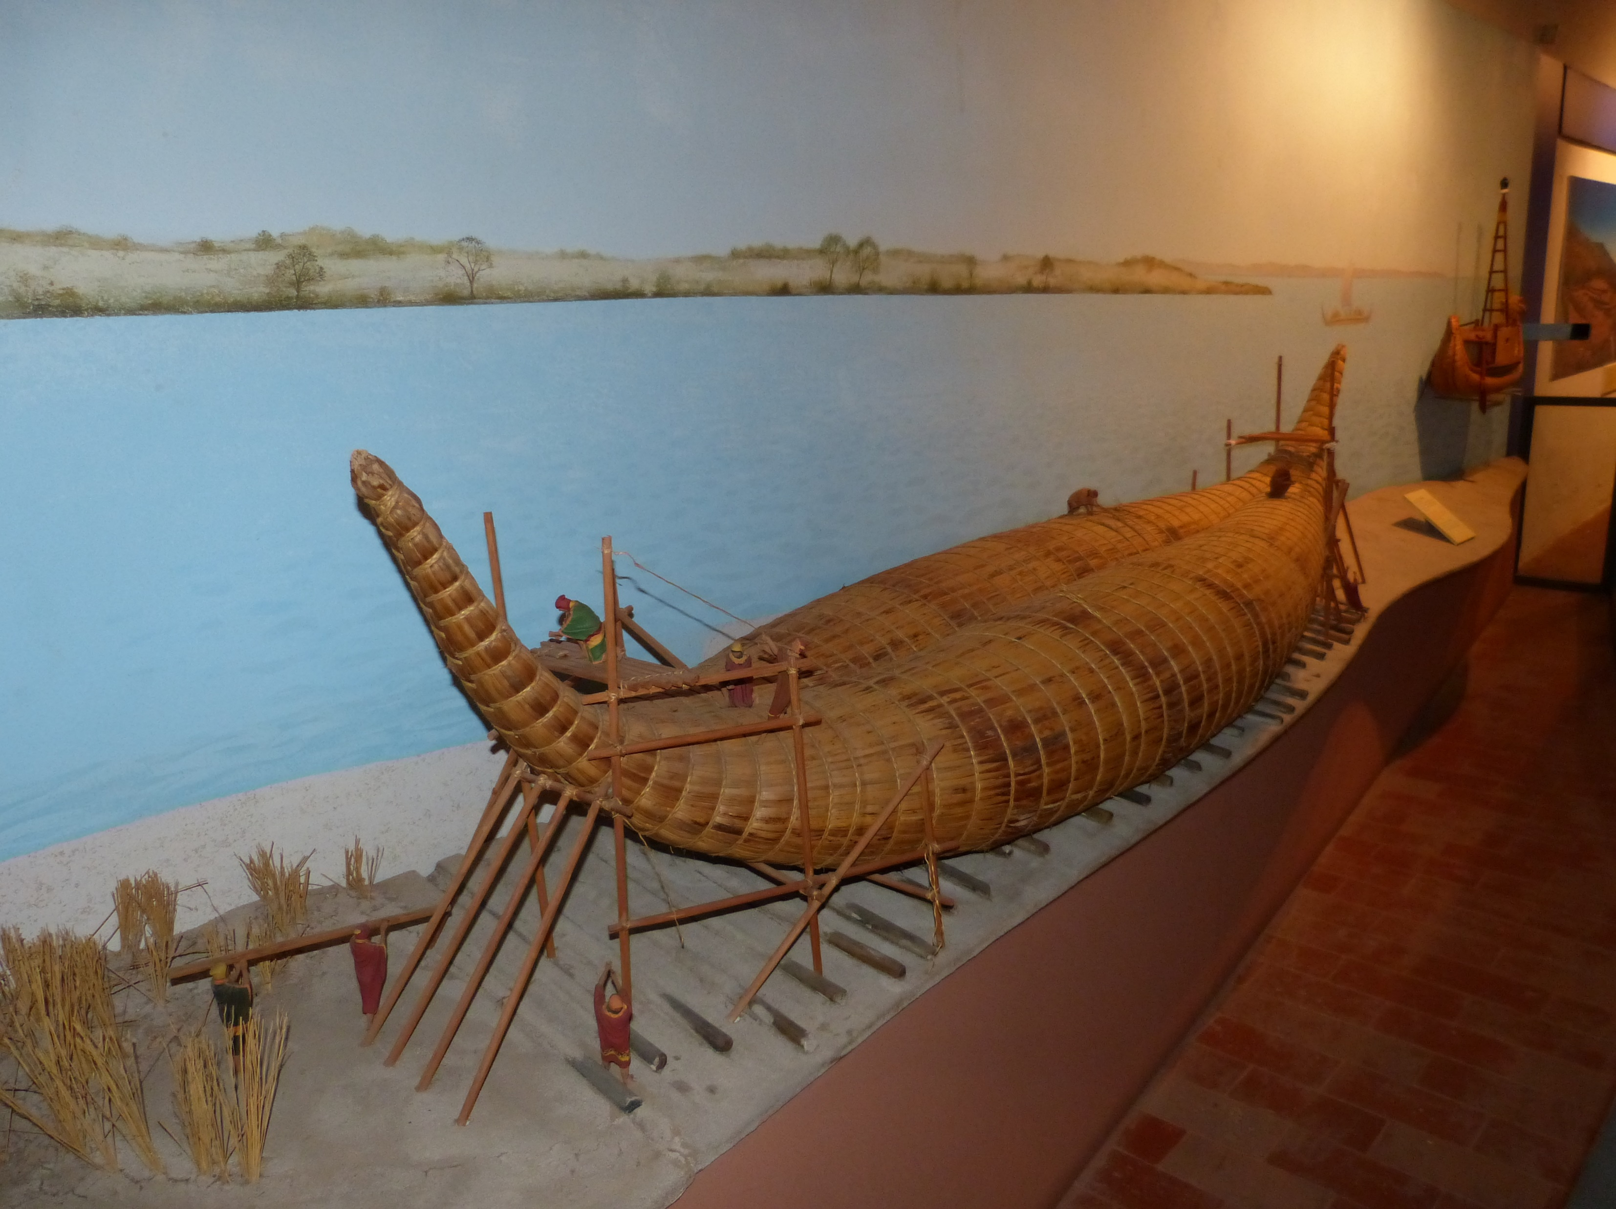

Ezekiel – Strength for Today
Ezekiel 1:1-3

Slide 2
Ezekiel – Strength for Today
Ezekiel 1:1-3
In my thirtieth year, in the fourth month on the fifth day, while I was among the exiles by the River Kebar, the heavens were opened, and I saw visions of God. On the fifth of the month – it was the fifth year of the exile of King Jehoiachin – the word of the Lord came to Ezekiel the priest, the son of Buzi, by the River Kebar in the land of the Babylonians. There the hand of the Lord was on him” (Ez.1:1-3).

Slide 3
Ezekiel – Strength for Today
Ezekiel 1:1-3
False hopes

Slide 4
Ezekiel – Strength for Today
Ezekiel 1:1-3
False hopes
Illusions

Slide 5
Ezekiel – Strength for Today
Ezekiel 1:1-3
False hopes
Illusions
Questioning God

Slide 6
Ezekiel – Strength for Today
Ezekiel 1:1-3
History:

Slide 7
Ezekiel – Strength for Today
Ezekiel 1:1-3
History:
722 B.C. “Goodbye 10 tribes” (Assyrian exile)

Slide 8
Ezekiel – Strength for Today
Ezekiel 1:1-3
History:
722 B.C. “Goodbye 10 tribes” –Assyrian exile.
612 BC Assyria defeated by Babylon
605 BC Nebuchadnezzar invaded (Daniel and nobles taken to Babylon – first deportation)
622 B.C birth of Ezekiel in Jerusalem
597 Jehoiachin rebelled against Babylon – second deportation (with Ezekiel)
586 Zedekiah rebelled – destruction of Temple and Jerusalem after 18-month siege – third deportation

Slide 9
Ezekiel – Strength for Today
Ezekiel 1:1-3
Ezekiel the prophet:
622 B.C birth of Ezekiel in Jerusalem (priestly family)

Slide 10
Ezekiel – Strength for Today
Ezekiel 1:1-3
Ezekiel the prophet:
622 B.C birth of Ezekiel in Jerusalem (priestly family)
Early years

Slide 11
Ezekiel – Strength for Today
Ezekiel 1:1-3
Ezekiel the prophet:
622 B.C birth of Ezekiel in Jerusalem (priestly family)
Early years
Death of Josiah (609 B.C.) and consequences

Slide 12
Ezekiel – Strength for Today
Ezekiel 1:1-3
Ezekiel the prophet:
622 B.C birth of Ezekiel in Jerusalem (priestly family)
Early years
Death of Josiah (609 B.C.) and consequences
Ezekiel deported

Slide 13
Ezekiel – Strength for Today
Ezekiel 1:1-3
Ezekiel the prophet:
622 B.C birth of Ezekiel in Jerusalem (priestly family)
Early years
Death of Josiah (609 B.C.) and consequences
Ezekiel deported
587/586 B.C. Fall of Jerusalem (Ezekiel 33:21)

Slide 14
Ezekiel – Strength for Today
Ezekiel 1:1-3
1. Ezekiel (prophet) – refugee

Slide 15
Ezekiel – Strength for Today
Ezekiel 1:1-3
Ezekiel – the refugee
  False hopers

Slide 16
Ezekiel – Strength for Today
Ezekiel 1:1-3
Ezekiel – the refugee
  False hopers
  No hopers (Ps.137)

Slide 17
Ezekiel – Strength for Today
Ezekiel 1:1-3
Ezekiel – the refugee
  False hopers
  No hopers (Ps.137)
  Complainers

Slide 18
Ezekiel – Strength for Today
Ezekiel 1:1-3
Ezekiel – the refugee
  False hopers
  No hopers (Ps.137)
  Complainers
‘Think that in every line you read that God is speaking to you’ (Thomas Watson – 1620-1686)

Slide 19
Ezekiel – Strength for Today
Ezekiel 1:1-3
Ezekiel – the refugee
Ezekiel – the call
“Son of man, I am sending you to the Israelites…go now to the house of Israel and speak my words to them” (2:3; 3:4).

Slide 20
Ezekiel – Strength for Today
Ezekiel 1:1-3
Ezekiel – the refugee
Ezekiel – the call
a) Early preparation

Slide 21
Ezekiel – Strength for Today
Ezekiel 1:1-3
Ezekiel – the refugee
Ezekiel – the call
Early preparation
Understanding of God’s purposes

Slide 22
Ezekiel – Strength for Today
Ezekiel 1:1-3
Ezekiel – the refugee
Ezekiel – the call
Early preparation
Understanding of God’s purposes
  Yahweh’s central place

Slide 23
Ezekiel – Strength for Today
Ezekiel 1:1-3
Ezekiel – the refugee
Ezekiel – the call
Early preparation
Understanding of God’s purposes
  Yahweh’s central place
  Abomination of sin

Slide 24
Ezekiel – Strength for Today
Ezekiel 1:1-3
Ezekiel – the refugee
Ezekiel – the call
Early preparation
Understanding of God’s purposes
  Yahweh’s central place
  Abomination of sin
  Ultimate sin = idolatry

Slide 25
Ezekiel – Strength for Today
Ezekiel 1:1-3
Ezekiel – the refugee
Ezekiel – the call
Early preparation
Understanding of God’s purposes
Ezekiel called to prophesy

Slide 26
Ezekiel – Strength for Today
Ezekiel 1:1-3
Ezekiel – the refugee
Ezekiel – the call
Early preparation
Understanding of God’s purposes
Ezekiel called to prophesy
  Jeremiah (Jerusalem)

Slide 27
Ezekiel – Strength for Today
Ezekiel 1:1-3
Ezekiel – the refugee
Ezekiel – the call
Early preparation
Understanding of God’s purposes
Ezekiel called to prophesy
  Jeremiah (Jerusalem)
  NT counterpart = John on Patmos

Slide 28
Ezekiel – Strength for Today
Ezekiel 1:1-3
Ezekiel – the refugee
Ezekiel – the call
Ezekiel – the mission field

Slide 29
Ezekiel – Strength for Today
Ezekiel 1:1-3
Ezekiel – the refugee
Ezekiel – the call
Ezekiel – the mission field
Fellow exiles

Slide 30
Ezekiel – Strength for Today
Ezekiel 1:1-3
Ezekiel – the refugee
Ezekiel – the call
Ezekiel – the mission field
Fellow exiles
Pagan surroundings

Slide 31
Ezekiel – Strength for Today
Ezekiel 1:1-3
Ezekiel – the refugee
Ezekiel – the call
Ezekiel – the mission field
Four main themes

Slide 32
Ezekiel – Strength for Today
Ezekiel 1:1-3
Ezekiel – the refugee
Ezekiel – the call
Ezekiel – the mission field
Four main themes
The transcendent glory of God

Slide 33
Ezekiel – Strength for Today
Ezekiel 1:1-3
Ezekiel – the refugee
Ezekiel – the call
Ezekiel – the mission field
Four main themes
The transcendent glory of God
The rebellious nature of man

Slide 34
Ezekiel – Strength for Today
Ezekiel 1:1-3
Ezekiel – the refugee
Ezekiel – the call
Ezekiel – the mission field
Four main themes
The transcendent glory of God
The rebellious nature of man
Possibility of repentance

Slide 35
Ezekiel – Strength for Today
Ezekiel 1:1-3
Ezekiel – the refugee
Ezekiel – the call
Ezekiel – the mission field
Four main themes
The transcendent glory of God
The rebellious nature of man
The inevitability of judgment

Slide 36
Ezekiel – Strength for Today
Ezekiel 1:1-3
Ezekiel – the refugee
Ezekiel – the call
Ezekiel – the mission field
Four main themes
The transcendent glory of God
The rebellious nature of man
The inevitability of judgment
Judgment begins at home

Slide 37
Ezekiel – Strength for Today
Ezekiel 1:1-3
Ezekiel – the refugee
Ezekiel – the call
Ezekiel – the mission field
Four main themes
The transcendent glory of God
The rebellious nature of man
The inevitability of judgment
Judgment begins at home
What the Lord requires

Slide 38
Ezekiel – Strength for Today
Ezekiel 1:1-3
Ezekiel – the deportee
Ezekiel – the call
Ezekiel – his mission field
Four main themes
The transcendent glory of God
The rebellious nature of man
The inevitability of judgment
The hope of restoration

Slide 39
Ezekiel – Strength for Today
Ezekiel 1:1-3
Ezekiel – the refugee
Ezekiel – the call
Ezekiel – the mission field
Four main themes
The transcendent glory of God
The rebellious nature of man
The inevitability of judgment
The hope of restoration
The glory will return

